Slide 1

What is it?

Slide 2
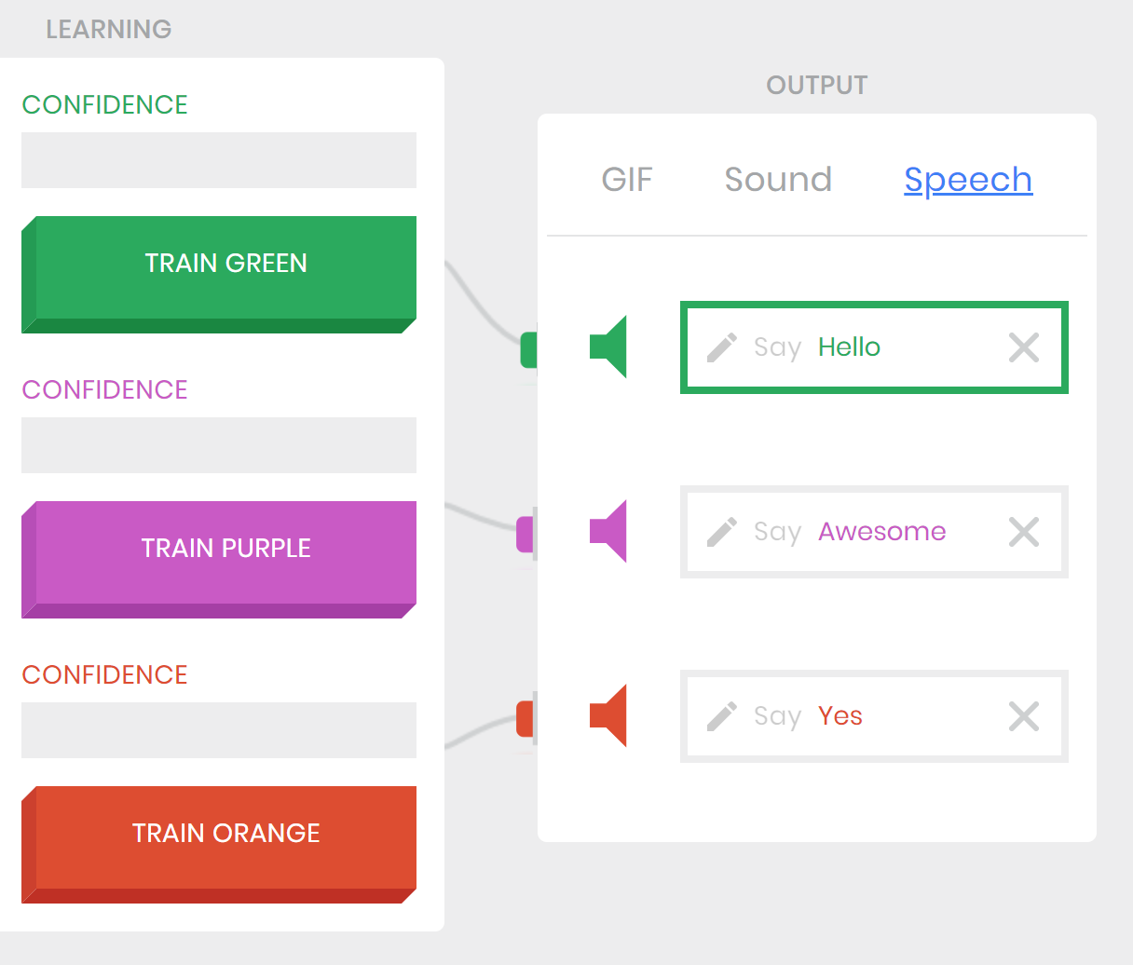
Recap
Last lesson, you taught Teachable Machine to recognize certain images.
Now, you are going to make your own image recognition machine using MIT App Inventor!

Slide 3
What is MIT App Inventor?
MIT App Inventor is a set of tools that let you make apps on Android devices.
You are going to make your own machine learning app to test out!
But App Inventor does not normally have support for machine learning… So we have to use an extension.

Slide 4
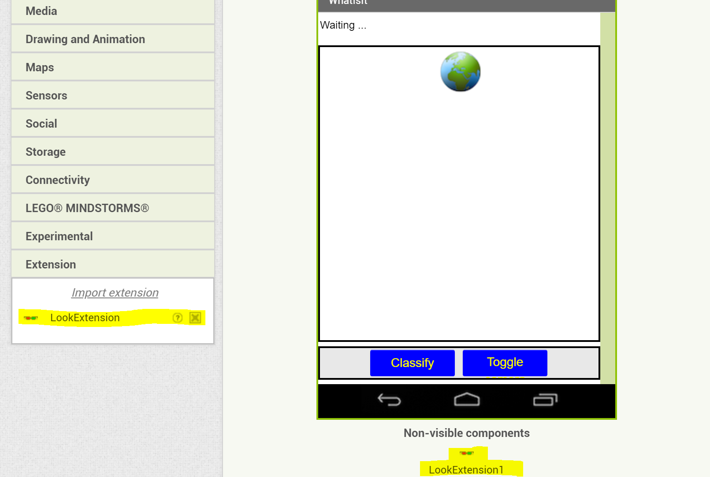
The Look Extension
The Look Extension is an extension to MIT App Inventor that helps run image classification on the app.
An extension is a set of rules
and blocks that are not originally
part of App Inventor, but can be
imported from an outside source.

Slide 5
The Look Extension
The extension will already be imported in the template you’ll be given, so what you have to do is finish writing the code for the app. A tutorial will explain the steps to you.
Once you’re done, you’ll be able to run it on your mobile devices. Just point the device’s camera at an object and press the “Classify” button!
The program will tell you what it thinks the object is, along with a numerical confidence between 0 and 1. The closer the confidence is to 1, the more sure it is of its answer. The closer it is to 0, the less sure. You want confidences to be high!

Slide 6
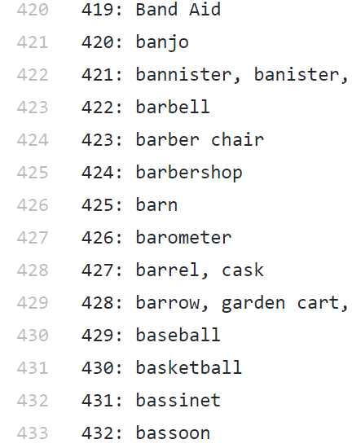
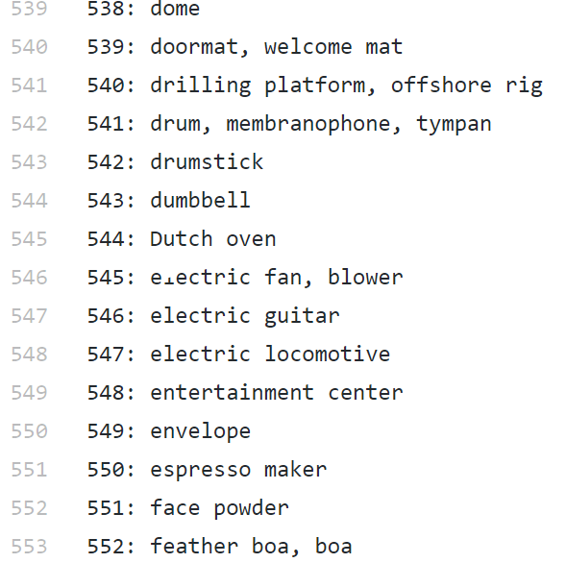
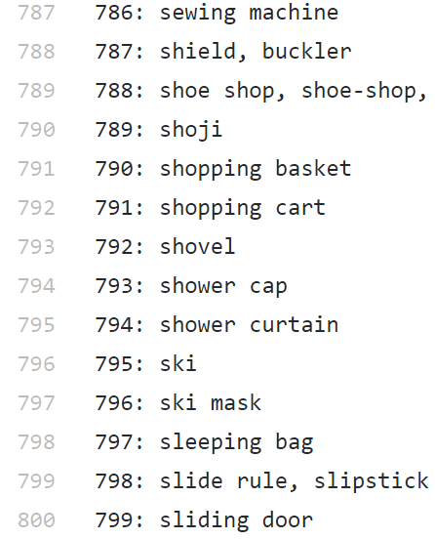
How it works
Just like Teachable Machine, the Look Extension uses machine learning to classify images. It has been trained using many many images.
Unlike Teachable Machine, the Look Extension has already gone through its training phase. Look Extension already has 999 different categories it is trained in, and so can recognize a lot of different images instead of just three!

Slide 7
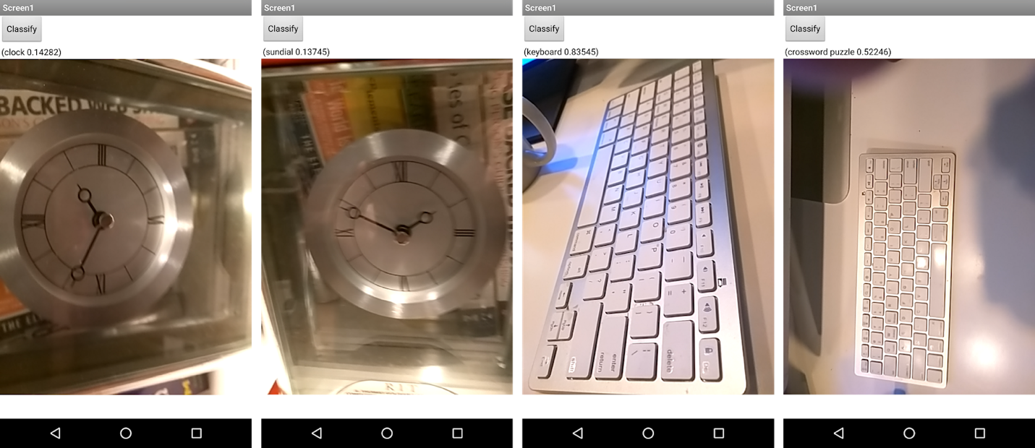
The Look Extension -- Examples
clock 0.14282 | sundial 0.13745 | keyboard 0.83545 | crossword puzzle 0.522446
Notes:
Different angles of the same image can give different results and confidences. These examples make sense -- a clock and sundial look similar, and a keyboard and crossword look similar.

Slide 8
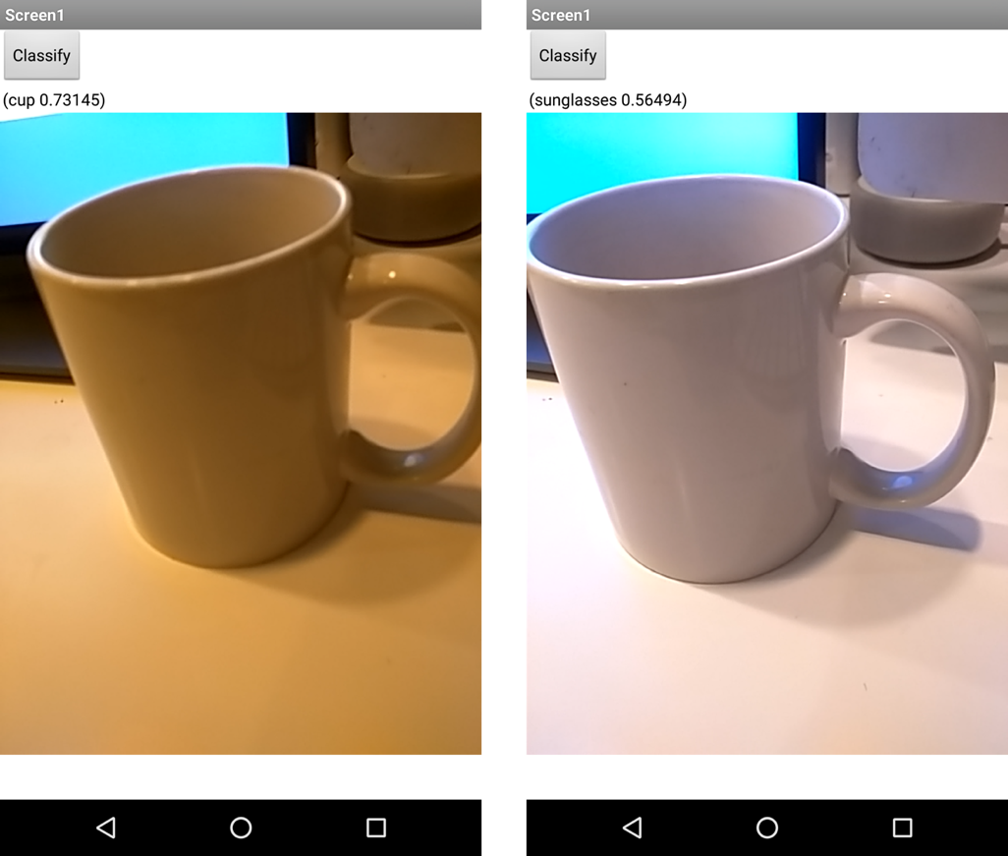
The Look Extension -- Examples
cup 0.73145 | sunglasses 0.56494
Notes:
This example is more mysterious -- a cup does not look like a pair of sunglasses. A slight change in angle makes the machine change its classification in the way a human mind would not. You may find other strange examples like this when you test your own app. From this you can see that machine learning and image recognition is not yet fully accurate, even with a lot of examples.

Slide 9
Once you’ve made the app… Do your own tests
Hold up an object, in front of the camera and have the app classify it.
Take the same object and change the angle. Reclassify. Does it classify it as the same thing?
Rotate it or move the camera farther away and reclassify. Does it classify it as the same thing?
Notes:
You can leave this slide open during the tutorial so that students can refer to it for the testing after.

Slide 10
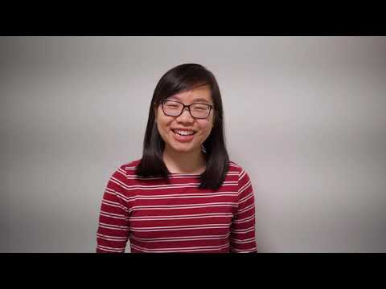
See how it works

